Slide 1
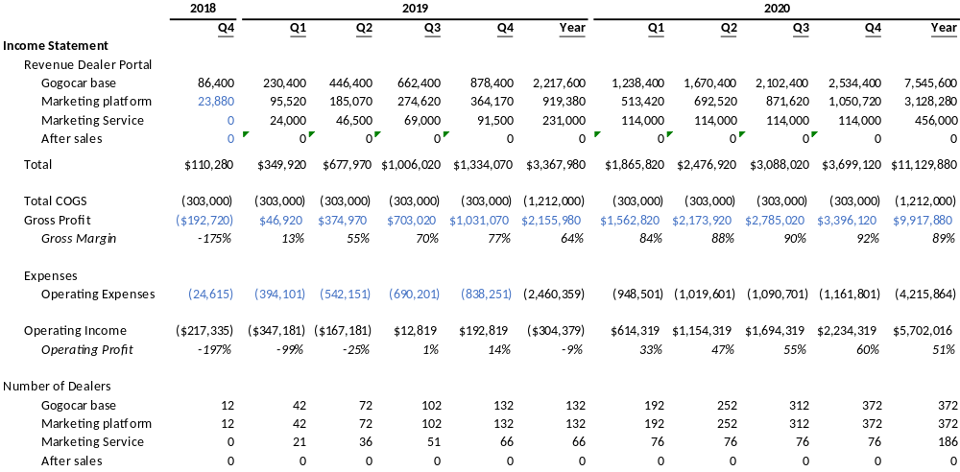
[Getting 2% penetration will generate yearly EBIT of [$5.7MM]]
Financial Projections
Monthly subscription $2400
Monthly subscription $1000
5% of marketing Budget
Only 2% penetration New Car Dealerships

Slide 2
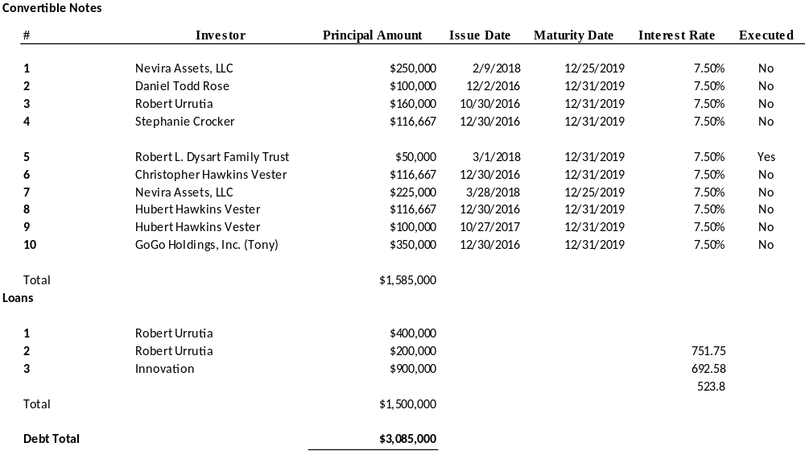
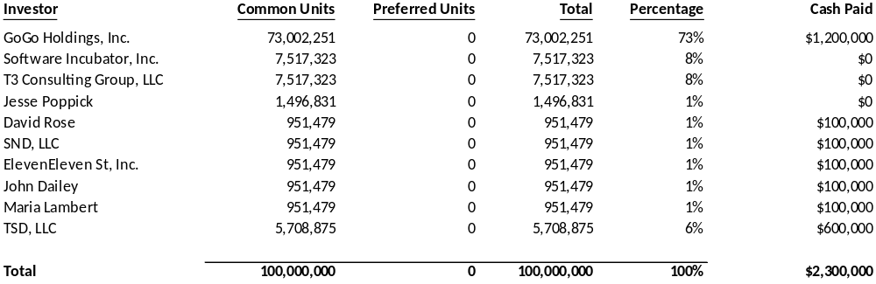
GoGoCar Has spent $5.3MM to Beta Test and Build the Platform
Debt and Equity
Equity
Debt

Slide 3
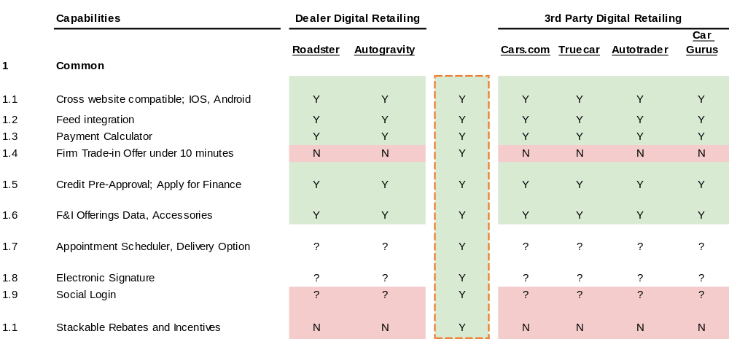

[Common]
Unique Competitive Advantages

Slide 4
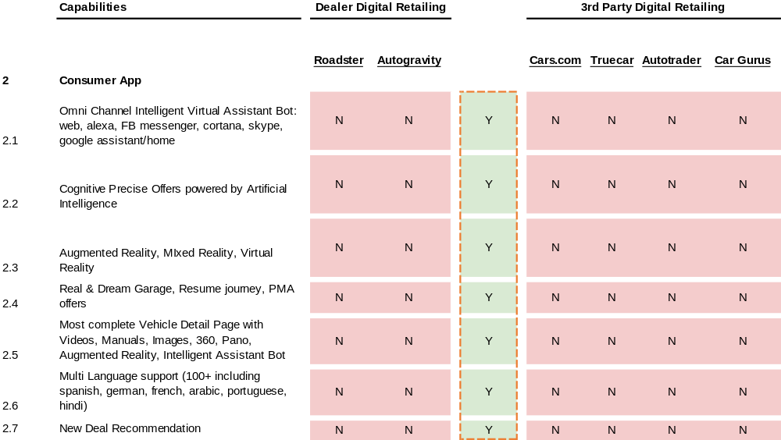
Consumer Portal
Unique Competitive Advantages

Slide 5
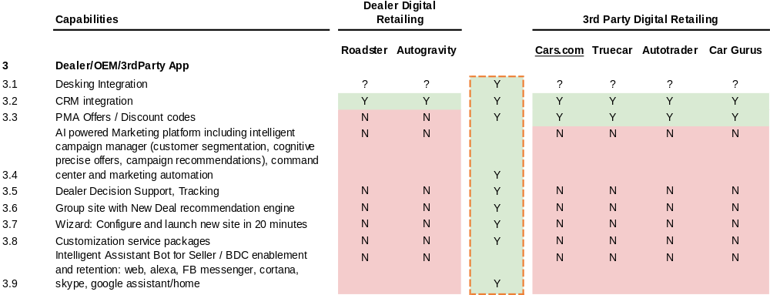
[Dealer/OEM/3rd Party App]
Unique Competitive Advantages

